Slide 1
Complements
Simplifies
  the subtraction operation
  Logical operations
Two types exist
  The radix complement (r’s complement)
    10’s complement, 2’s complement
  The diminished radix complement ((r-1)’s complement)
    9’s complement, 1’s complement

Slide 2
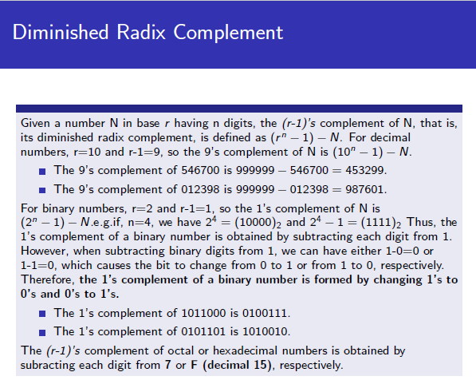


Slide 3
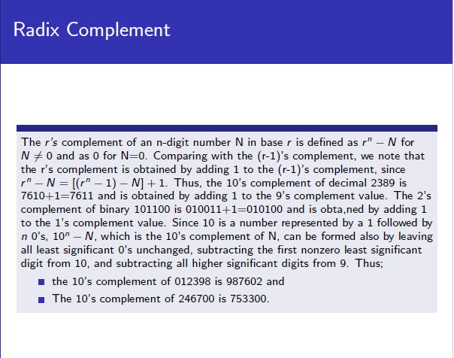

Slide 4
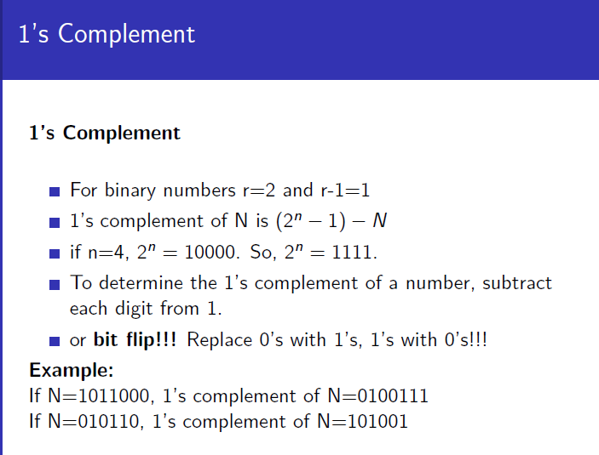

Slide 5
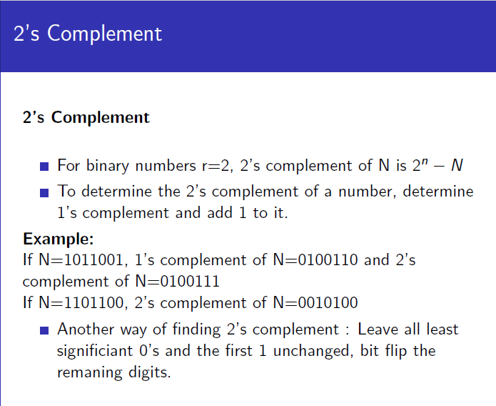

Slide 6
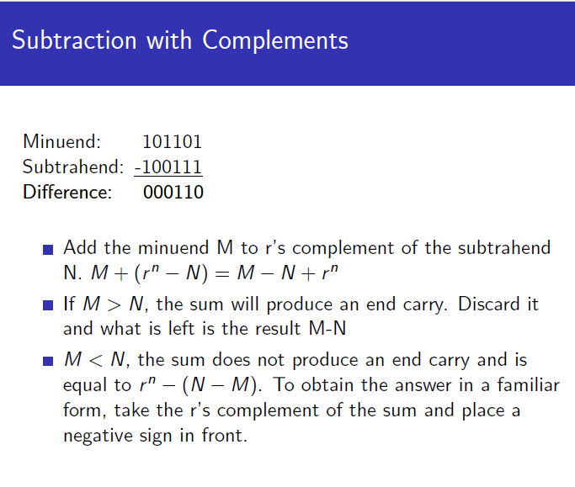

Slide 7
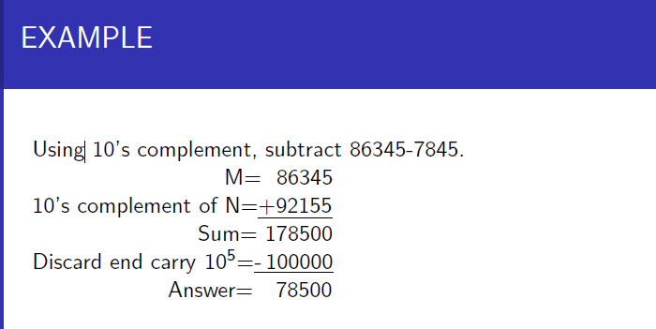

Slide 8
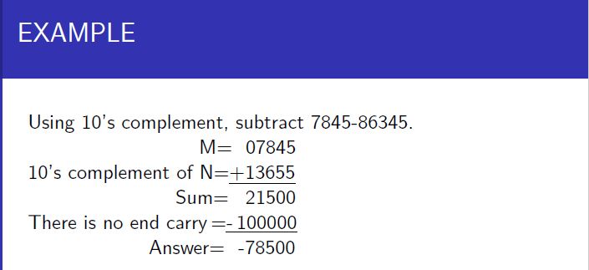

Slide 9
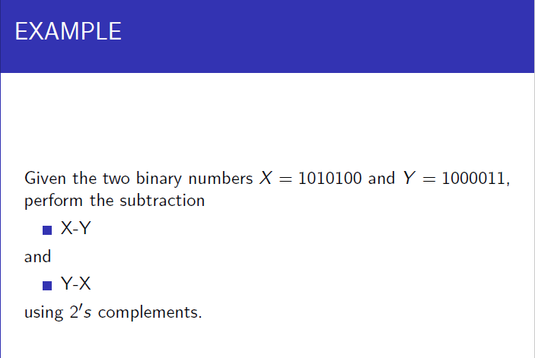

Slide 10











Slide 11
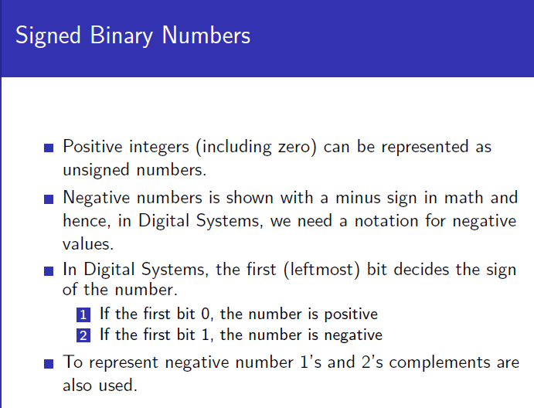


Slide 12
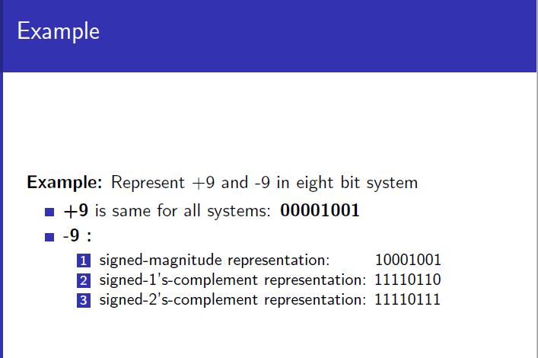

Slide 13
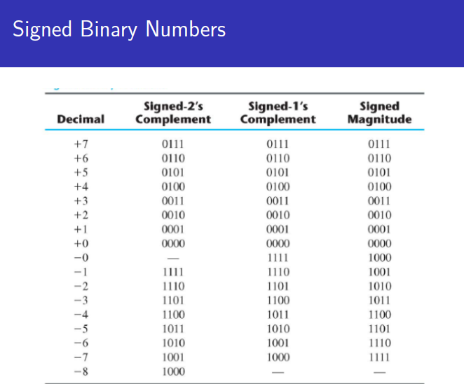

Slide 14
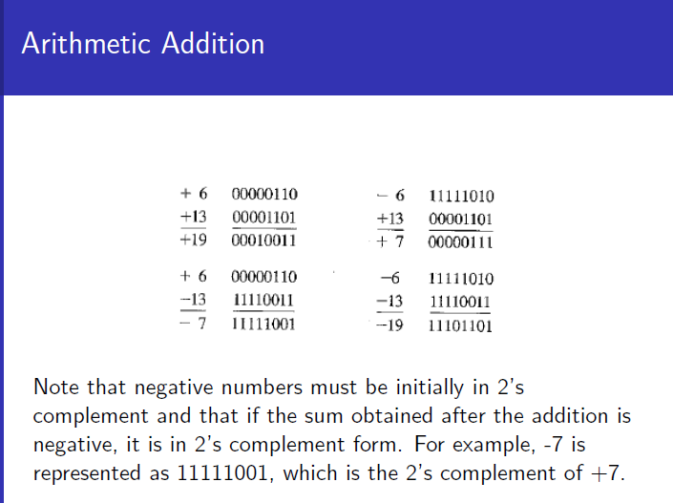

Slide 15
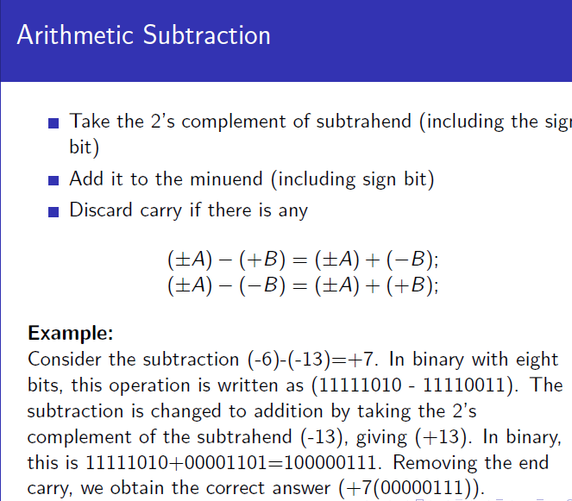

Slide 16
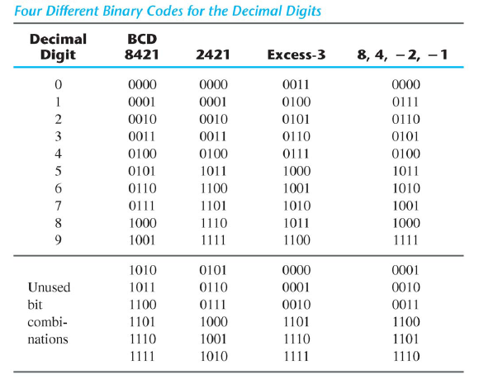
Other Decimal Codes

Slide 17
Other Decimal Codes

Slide 18
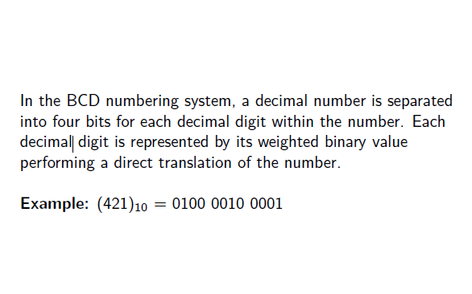
BCD Numbers

Slide 19
BCD Addition
While adding 2 BCD numbers we have to deal with 3 cases.
Sum <=9, Final carry=0
In the first case, when sum is less than or equal 9 and final carry is equal to 0. The answer obtained is correct. In BCD addition we only have to perform simple binary addition.
2. Sum <=9, Final carry=1
In the second case, when sum is less than or equal to 9 and final carry is equal to 1. The answer obtained incorrect and we have to correct our answer. To correct our answer we will just add 6 (0110) to our answer.
3. Sum >9, Final Carry=0
In the third case, when sum is greater than 9 and final carry is equal to zero. The answer obtained is incorrect. To correct it we need add 6 again.

Slide 20
Examples
Ex.1. Based on Case 1.
If Sum <=9, Final carry=0
we only have to perform simple binary addition.
(0010)₂=(2)₁₀
(0110)₂=(6)₁₀
----------------
(1000)₂=(8)₁₀

Slide 21
Examples
Ex.2. Based on Case 2.
If Sum <=9, Final carry=1
To correct our answer we will just add 6 (0110) to our answer.
(1000)₂=(8)₁₀
(1001)₂=(9)₁₀
----------------
(1 0001)₂=(17)₁₀ ???
(0001 0001) =11
( 0110) =6
---------------------
(0001 0111)=17

Slide 22
Examples
Ex.3. Based on Case 3.
If Sum >9, Final Carry=0
To correct our answer we will just add 6 (0110) to our answer.
(0011)₂=(3)₁₀
(0111)₂=(7)₁₀
----------------
(1010)₂=(10)₁₀ ???
( 1010) =10 ???
( 0110) =6
---------------------
(0001 0000)=10

Slide 23
Examples
Ex.4. In this example we want to perform the addition 57 plus 26.
0101 0111 = 57 and
0010 0110 = 26
_______________
0111 1101 is the answer ?

Slide 24
Other Decimal Codes

Slide 25
Gray Codes
Only one bit changes when going from one number to the next.
How to determine the gray code equivalent of a number:
  Add 0 to the left of number.
  XOR every two neigboring pair in order.
  The result is the gray code.
Example: 1 1 0 0 0 0 -> 0 1 1 0 0 0 0
1 0 1 0 0 0

Slide 26
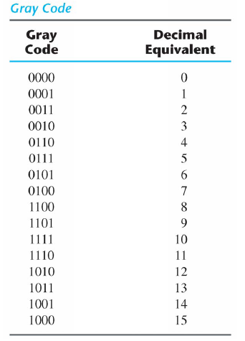

Slide 27
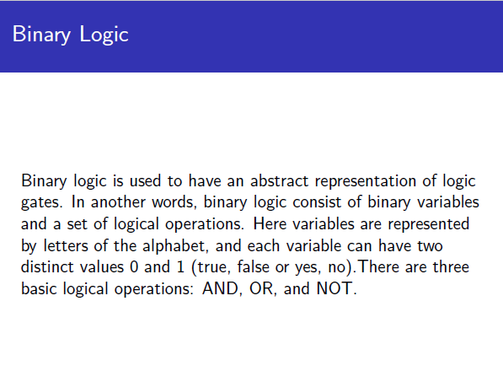

Slide 28
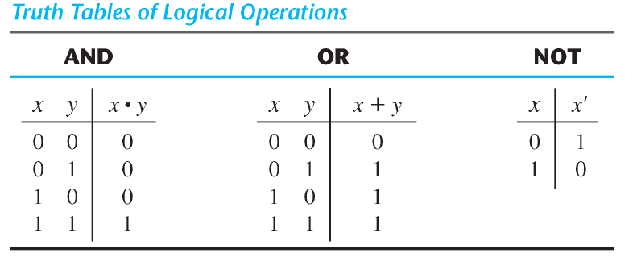
Truth tables

Slide 29



Gate sysbols

Slide 30
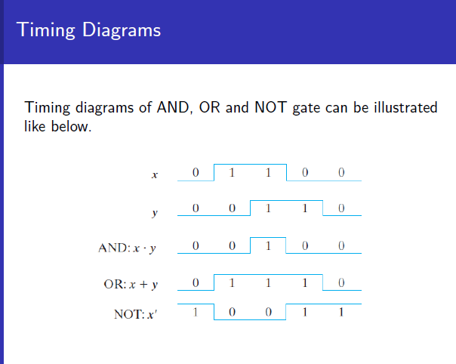

Slide 31
Boolean Algebra
Logic Gates
Chapter 2

Slide 32
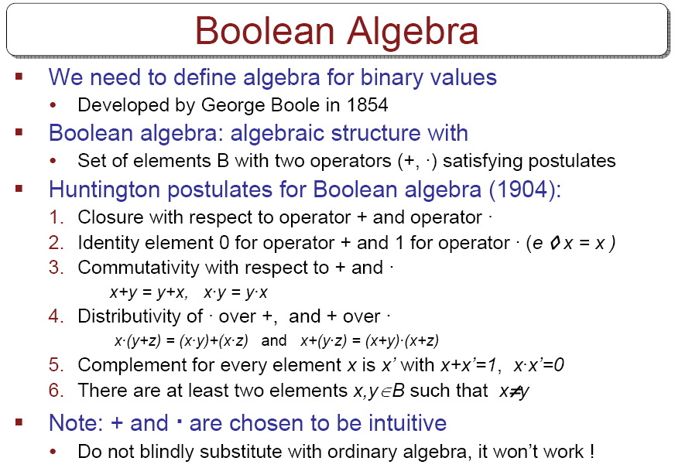

Slide 33
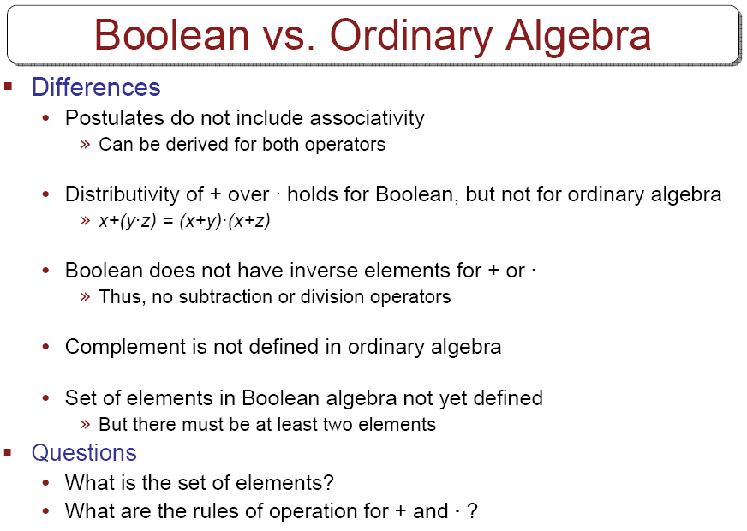

Slide 34
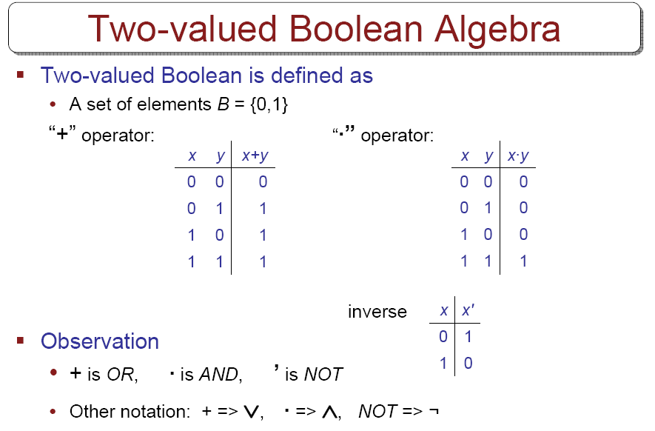

Slide 35
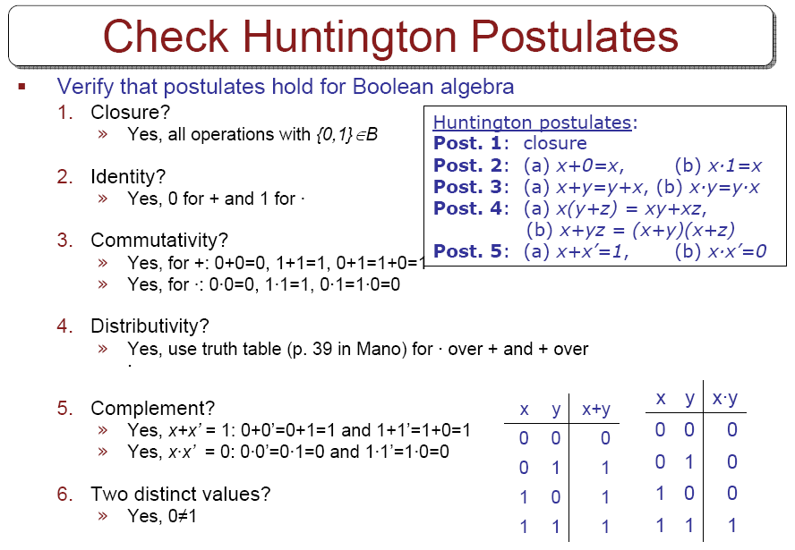
p. 56 in Mano

Slide 36
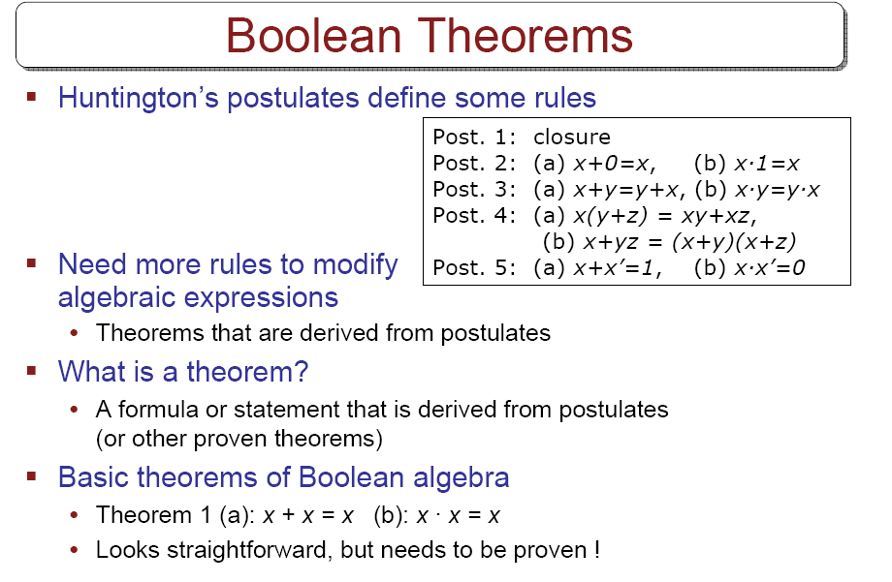

Slide 37
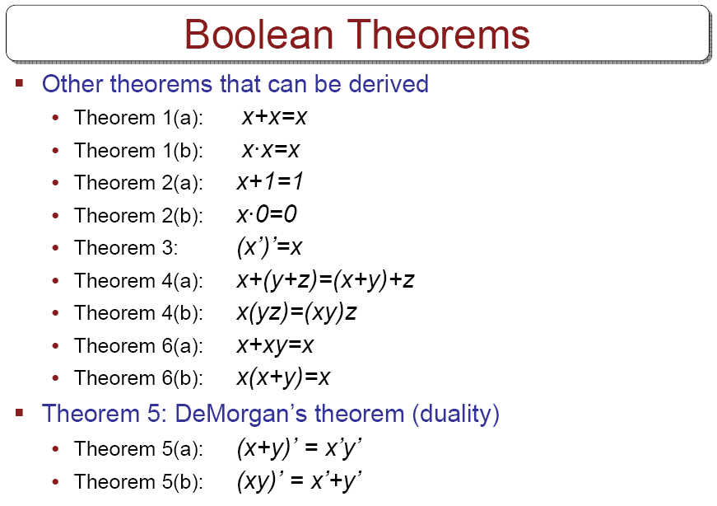

Slide 38
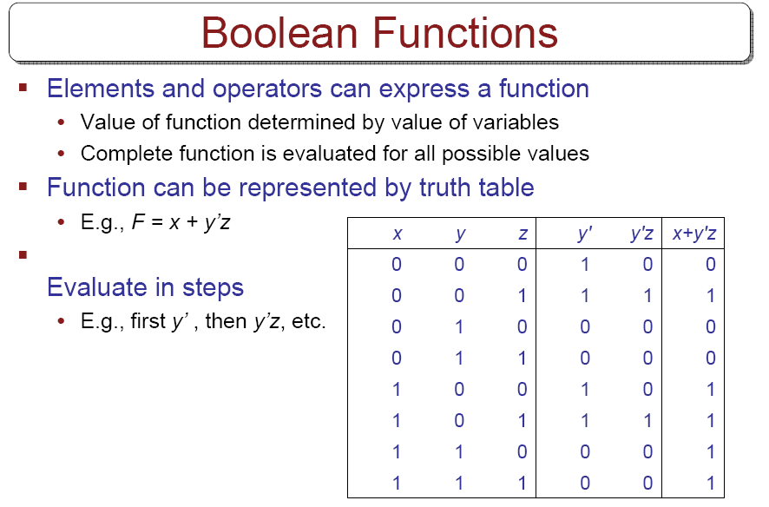

Slide 39
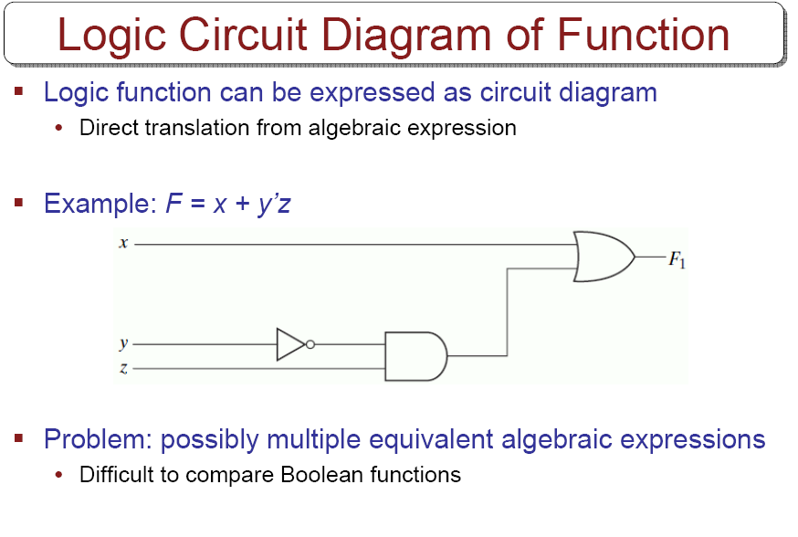

Slide 40
Algebraic Manipulation
Examples
  x(x’+y) =?
  2) x+x’y =?
  3) (x+y)(x+y’) =?
  4) xy + x’z + yz =?
  5) (x + y)(x’ + z)(y + z)

Slide 41
Complement of a Function
Use DeMorgan’s theorem.
  (A + B + C)’ = (A + x)’ => B+C=x
  = A’x’ => DeMorgan (5a)
  =A’(B+C)’ => substitute B+C=x
  =A’(B’C’) => DeMorgan (5a)
  =A’B’C’ => associative (4b)
Generalized DeMorgan’s theorem
  (A+B+C+…+F)’=A’B’C’…F’
  (ABC…F)’=A’+B’+C’+…+F’

Slide 42
Example
Find the complement of the following functions
    F=(x’yz’+x’y’z)
    G=[x(y’z’+yz)]
  Take duals
  Complement each literal

Slide 43
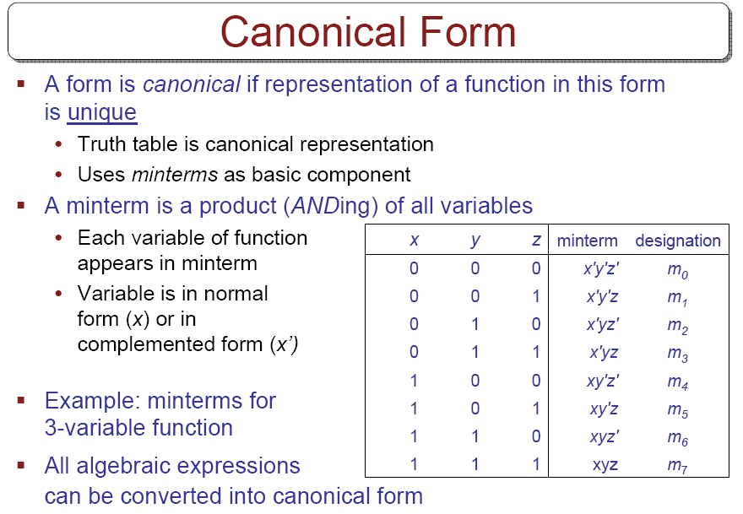

Slide 44
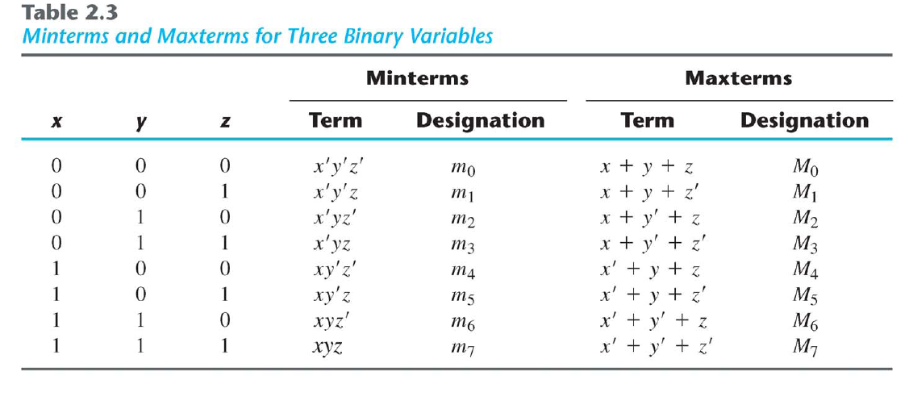
Minterms & Maxterms

Slide 45
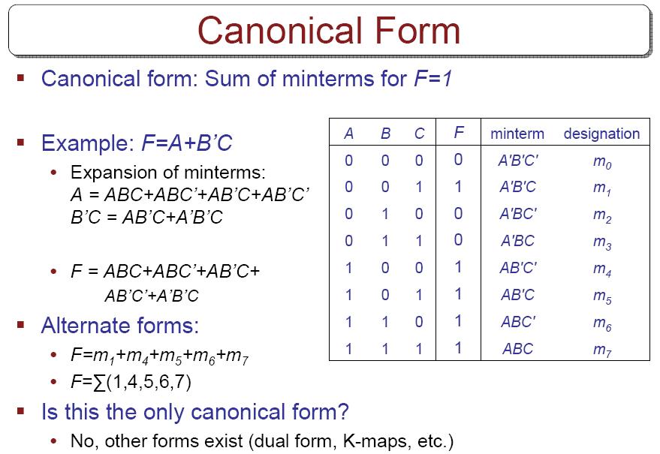

Slide 46
PRODUCT OF MAXTERMS
F=A+B’C
A | B | C | F
0 | 0 | 0 | 0
0 | 0 | 1 | 1
0 | 1 | 0 | 0
0 | 1 | 1 | 0
1 | 0 | 0 | 1
1 | 0 | 1 | 1
1 | 1 | 0 | 1
1 | 1 | 1 | 1

Slide 47
f1=x’y’z+xy’z’+xyz=m1+m4+m7
f2=x’yz+xy’z+xyz’=m3+m5+m6+m7
Complement of f1
  f1’=x’y’z’+x’yz’+x’yz+xy’z+xyz’
Take the complement of f1’ to obtain f1 in maxterms
  f1=(x+y+z)(x+y’+z)(x+y’+z’)(x’+y+z’)(x’+y’+z)
  =M0.M2.M3.M5.M6 = Π (0,2,3,5,6)
  f2=? in maxterms

